Slide 1
MID: A MetaCASE Tool for a Better Reuse of Visual Notations
Amine El Kouhen, Abdelouahed Gherbi, Cédric Dumoulin, Pierre Boulet, Sébastien Gérard

Slide 2
Agenda
Context
Issues
Proposal
Evaluation
Conclusion
SAM 2014
29 September 2014

Slide 3
Context

Slide 4
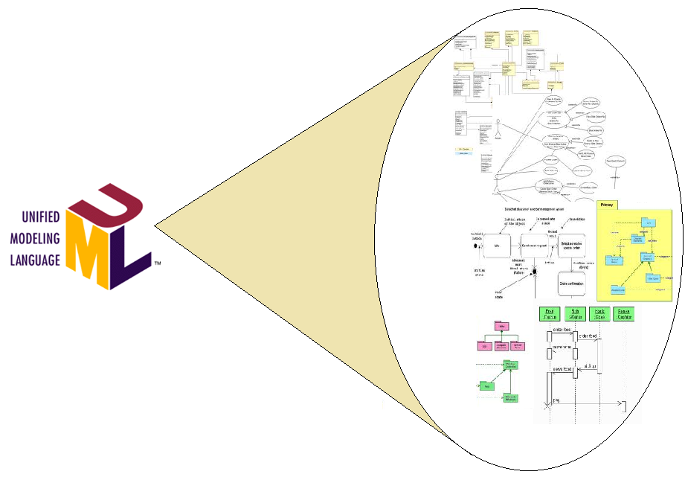
Papyrus
SAM 2014
29 September 2014

Slide 5
Papyrus : Key Figures
Over 8 years of development
15 committers
5,6 million Line Of Code
82% of code dedicated to diagram editors
Thousands of users (36.873 download in June 2014)
SAM 2014
29 September 2014

Slide 6
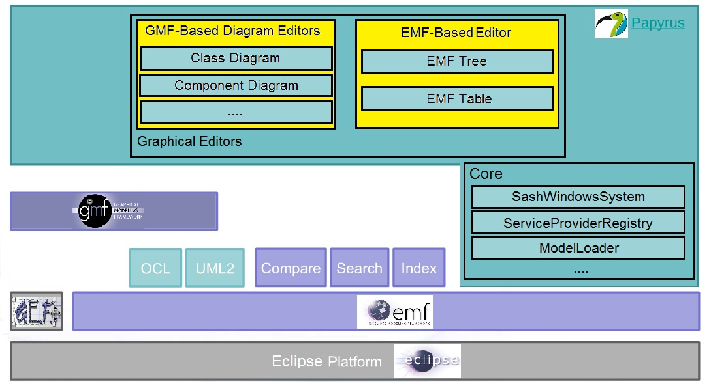
Papyrus : architecture
SAM 2014
29 September 2014

Slide 7
Issues
Diagram editors specification through models
Reusing diagrams elements specification
SAM 2014
29 September 2014

Slide 8
Issue 1 : Editors Specification
Specifying an editor consists of :
Define the languages ​​in which the diagrams are transcribed;
Define editors interactions;
Define links between diagram elements and the domain;
Define editors tooling.
SAM 2014
29 September 2014

Slide 9
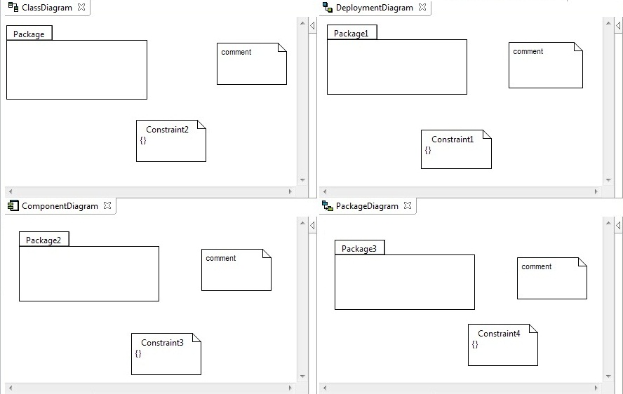
Issue 2 : Diagrams Reuse
SAM 2014
29 September 2014

Slide 10
State of the ART

Slide 11
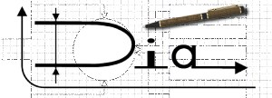
State of the art (1)
MetaCASE Environnements :
SAM 2014
29 September 2014

Slide 12
State of the art (2)
Evaluated tools Classification :
Code-based specification
MetaDescription-based specification
Specification based on graph grammar
Graphical drawer
Tools based on UML profiles
Tools based on DSLs
SAM 2014
29 September 2014

Slide 13
State of the art (3)
Evaluation Results :
Specification method
often cumbersome.
Graphical expressiveness
limited capability (pictures, UML CS reuse).
Reusability
Reuse by copy: consistency and maintenance problems.
Separation of Concerns
Mixing the form and the content.
SAM 2014
29 September 2014

Slide 14
Proposal : MID MEtamodEls For USER Interfaces and diagrams

Slide 15
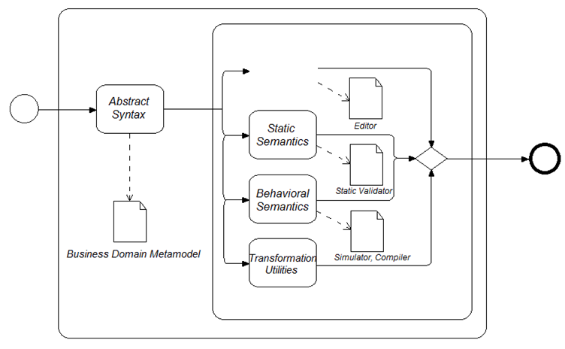
contributions positioning
J-M Jezequel, B. Combemale, D. Vojtisek, "Ingénierie Dirigée par les Modèles"
SAM 2014
29 September 2014

Slide 16
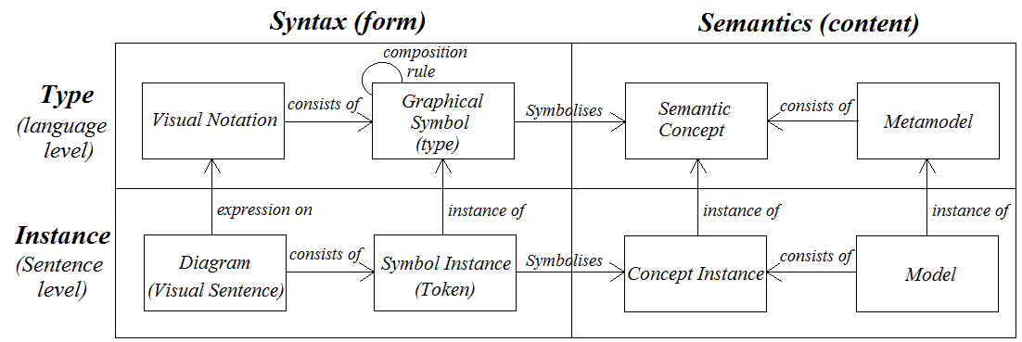
Visual Languages
The nature of diagrams :
D.L. Moody, "The Physics of Notations"
SAM 2014
29 September 2014

Slide 17
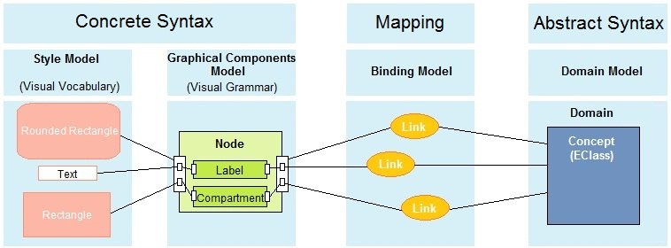
proposal Overview
MID
SAM 2014
29 September 2014

Slide 18
Challenge (1)
Diagram editors specification through models
Reusing diagrams elements specification
SAM 2014
29 September 2014

Slide 19
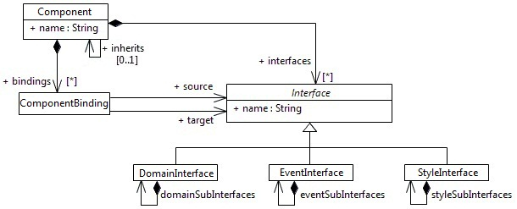
MID : Component Concept
SAM 2014
29 September 2014

Slide 20
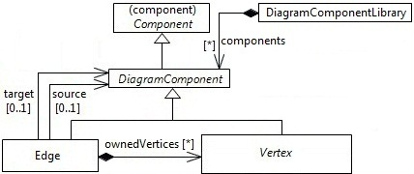
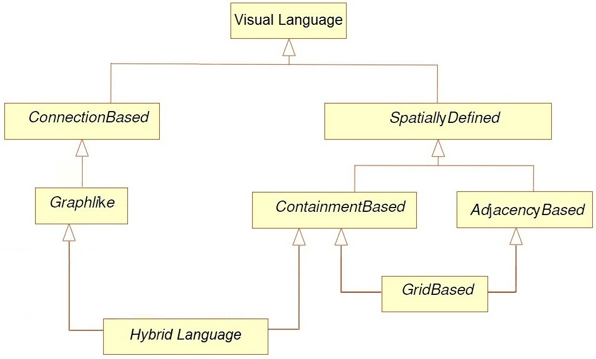
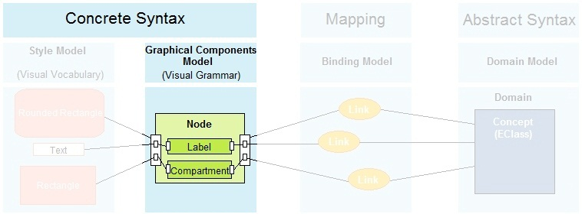
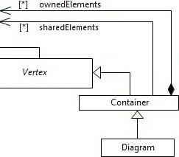
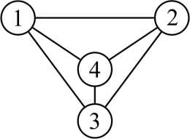
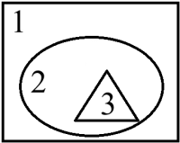
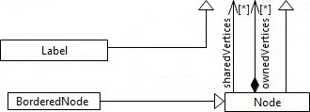
MID : Visual Grammar
P. Bottoni, A. Grau, "A Suite of Metamodels as a Basis for a Classification of Visual Languages"
SAM 2014
29 September 2014

Slide 21
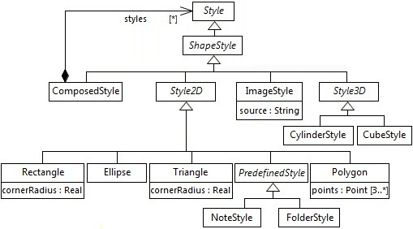
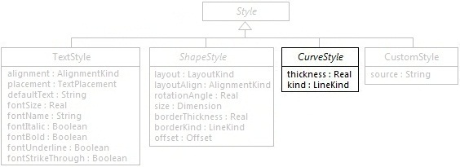
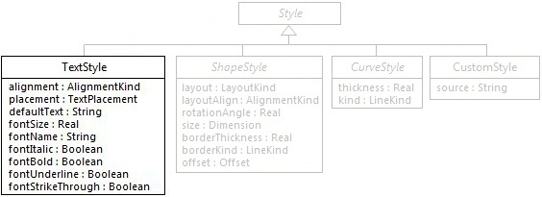
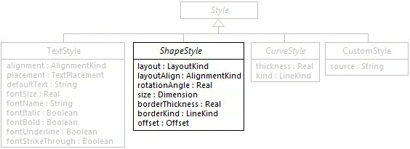
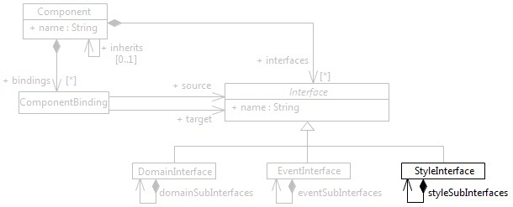
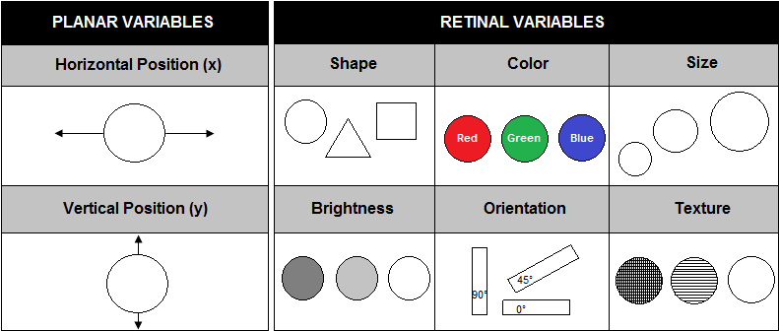
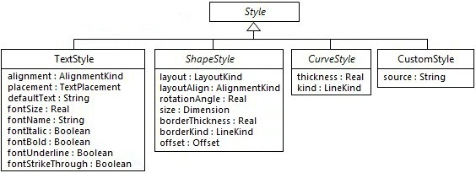
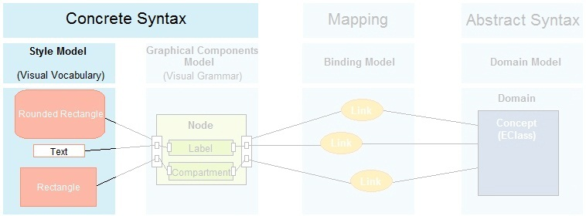
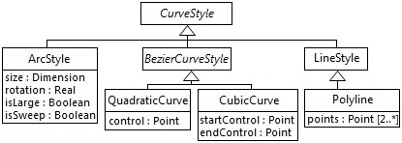
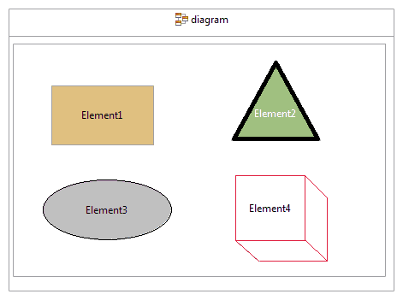
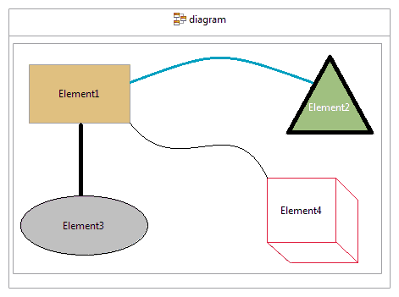
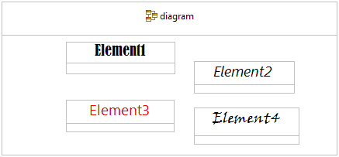
MID : Visual vocabulary
J. Bertin, "Semiology of Graphics"
SAM 2014
29 September 2014

Slide 22
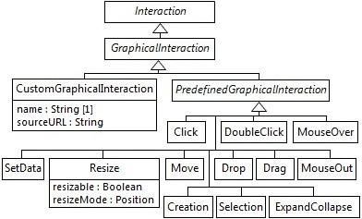
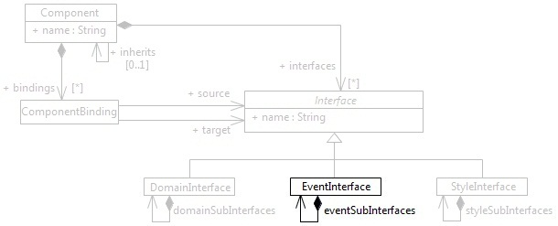
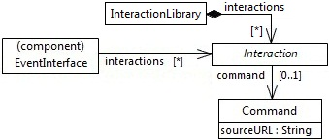
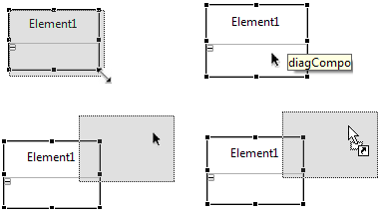
MID : Interactions
SAM 2014
29 September 2014

Slide 23
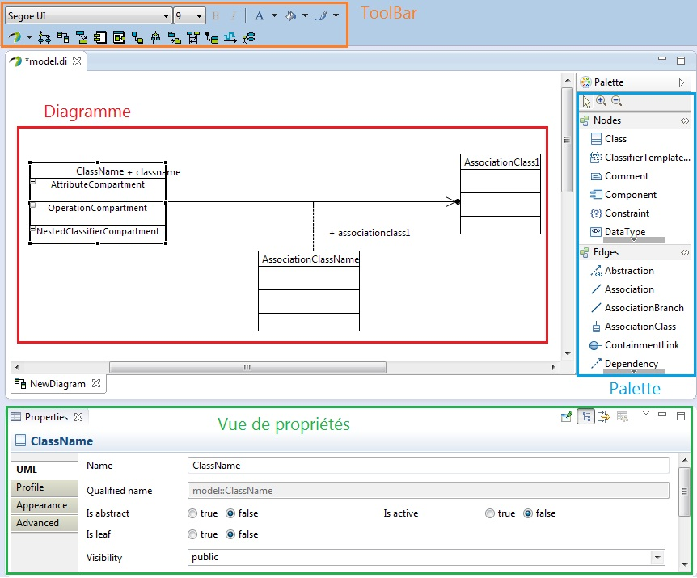
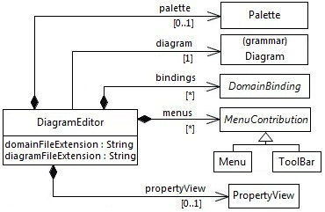
MID : EDITORS Assembly
SAM 2014
29 September 2014

Slide 24
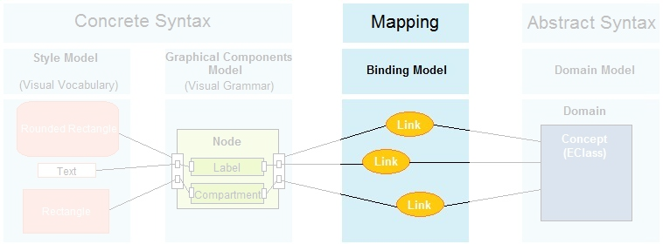
MID : Domain Binding
SAM 2014
29 September 2014

Slide 25
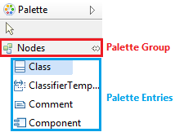
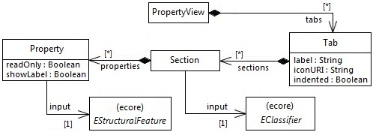
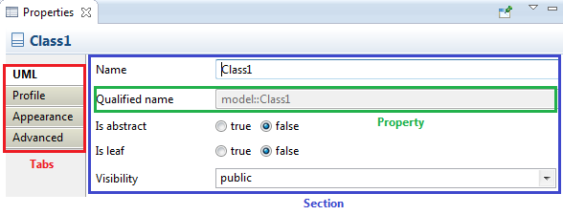
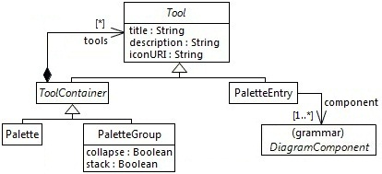
MID : Editor tooling
Property view
Palette
SAM 2014
29 September 2014

Slide 26
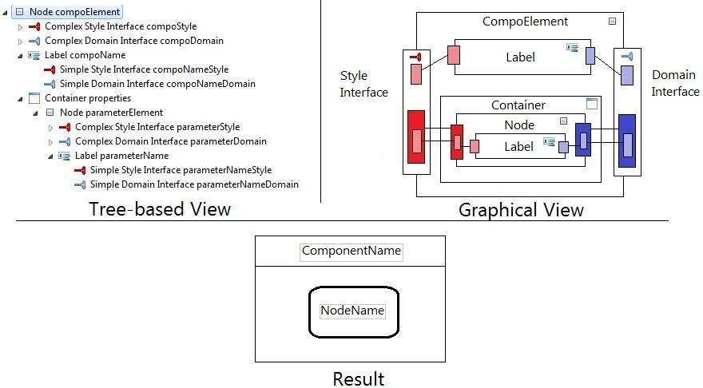
MID : Graphical Formalism
SAM 2014
29 September 2014

Slide 27
ISSUE (2)
Diagram editors specification through models
Reusing diagrams elements specification
SAM 2014
29 September 2014

Slide 28
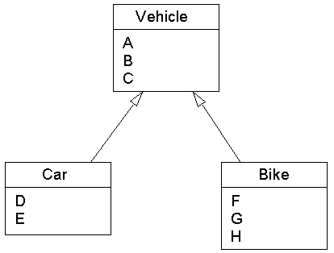
Reusability
Event
Style
Domain
SAM 2014
29 September 2014

Slide 29
Reusability : Composition
Component-based Approach :
Allows to create new editors by assembling pre-defined components.
Reduce costs of specification and reuse.
Insure a better maintenance through encapsulation.
Appropriate for industrializing the development of graphical editors.
SAM 2014
29 September 2014

Slide 30
Reusability : Separation of concerns
A good separation of concerns :
Reduce costs of maintenance.
Insure a better maintenance and reuse of specifications.
Allows to create new applications by assembling existent models.
SAM 2014
29 September 2014

Slide 31
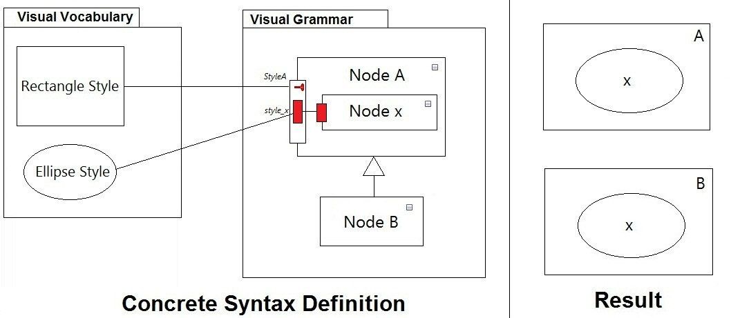
Reusability : Graphical Inheritance Mechanism (1)
Inheritance:
SAM 2014
29 September 2014

Slide 32
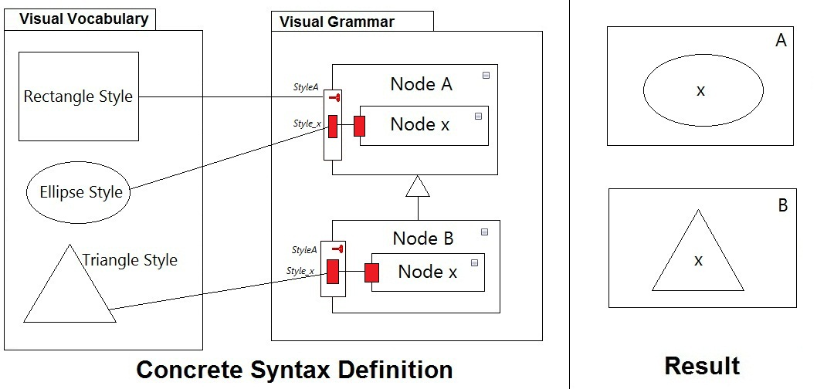
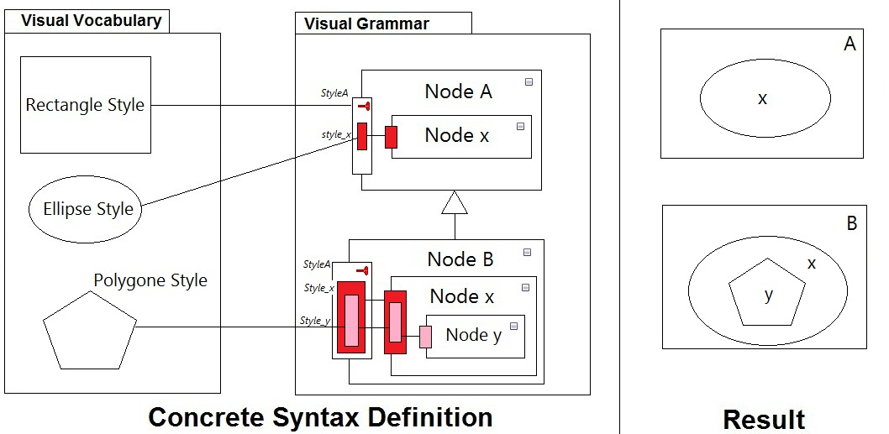
Reusability : Graphical Inheritance Mechanism (2)
Overriding :
SAM 2014
29 September 2014

Slide 33
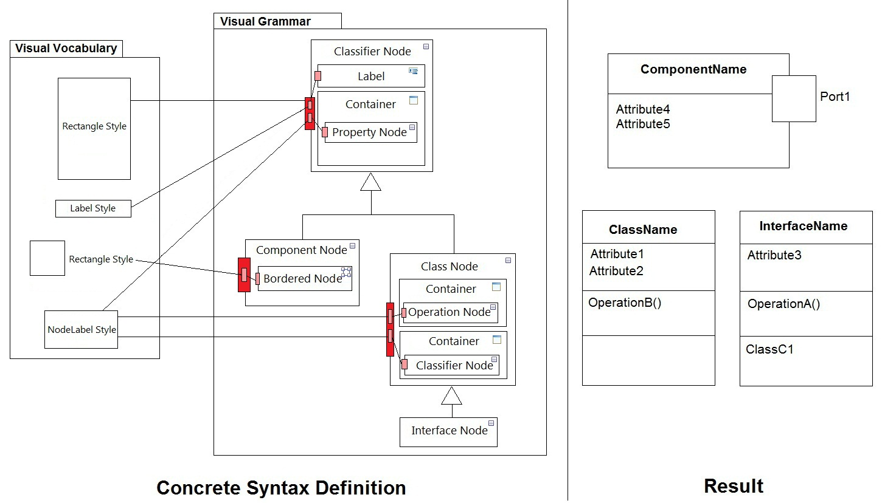
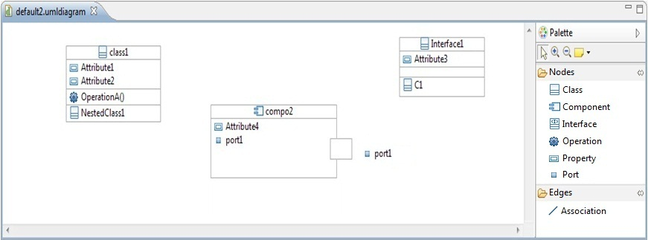
Diagram elements reuse
SAM 2014
29 September 2014

Slide 34
evaluation Results (1)
Specification method : component-based approach.
Insure a better maintenance through Encapsulation.
Insure reusability of diagram components by using Composition and Inheritance.
Appropriate for industrializing the development of graphical editors.
➔ Significant gain of productivity.
SAM 2014
29 September 2014

Slide 35
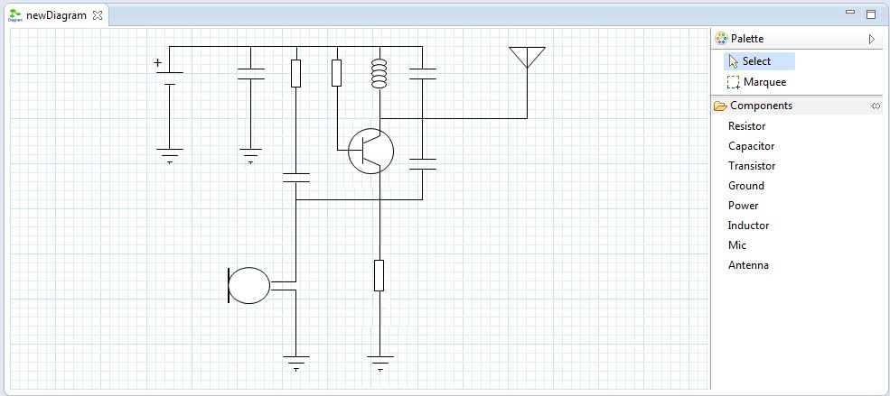
evaluation Results (2)
Graphical Expressiveness : MID allows specifying all UML diagrams even the more complex and other kind of languages.
SAM 2014
29 September 2014

Slide 36
evaluation Results (3)
Separation of Concerns : Separation of the concrete syntax (Vocabulary & Grammar) and the abstract syntax.
Abstraction level
Diagram Definition
MID
MetaEdit +
Spray
GME
GMF
Obeo Designer
IBM RSA
GEF
Graphiti
Separation of concerns
SAM 2014
29 September 2014

Slide 37
Evaluation results (4)
Reusability :
reuse by composition.
reuse by the separation of concerns.
Inheritance mechanism to reuse the concrete syntax.
Tools | Reuse Rate
MID | 71 %
Spray | 64 %
GMF | 52,3 %
MetaEdit+ | 46,9 %
Obeo Designer / Sirius | 34,8 %
SAM 2014
29 September 2014

Slide 38
Conclusion
We propose :
A set of metamodels to specify graphical editors.
Component-based Approach to support reuse.
A better separation of concerns for a better maintenance.
Inheritance mechanism to reuse, extend and specialize the specification.
.
We can then :
Specify complex visual languages with a better graphical expressiveness.
achieve a high reuse rate when we specify diagram editors.
SAM 2014
29 September 2014

Slide 39
Direction de Recherche Technologique Département Ingénierie Logiciels et Systèmes Laboratoire d’Ingénierie Dirigée par les Modèles pour les Systèmes Embarqués
Questions ??
Commissariat à l’énergie atomique et aux énergies alternatives
Centre de Saclay | 91191 Gif-sur-Yvette Cedex
T. +33 (0)3 59 22 36 05 | M. +33 (0)6 02 07 77 36
Etablissement public à caractère industriel et commercial | R.C.S Paris B 775 685 019

