Slide 1
Insights on the Use of OCL in Diverse Industrial Applications
Shaukat Ali¹, Tao Yue¹, Muhammad Zohaib Iqbal^{2, 3}, Rajwinder Kaur Panesar-Walawege¹
¹ Simula Research Laboratory, Norway
² National University of Computer & Emerging Sciences, Islamabad, Pakistan
³ SnT Luxembourg, Luxembourg

Slide 2
Outline of the Presentation
Motivation and Contributions
The Object Constraint Language (OCL)
Terminology related to OCL
Industrial Applications
Discussion

Slide 3
The Object Constraint Language

Slide 4
The Object Constraint Language
Standard language for writing constraints on UML models
First order logic and is a highly expressive language
Class and state invariants, guards in state machines, constraints in sequence diagrams, and pre and post conditions of operations
Constraints on UML profiles and metamodels

Slide 5
Motivation and Contributions

Slide 6
Motivation and Contributions
Clear and precise definitions of commonly used terminology related to the use of OCL
A clear relationship among the different purposes (e.g., OCL solving and evaluation) that OCL can be used for
Key results from our industrial applications of OCL
Guide practitioners in choosing when to apply OCL for a particular purpose and at which meta level

Slide 7
Terminology related to OCL

Slide 8
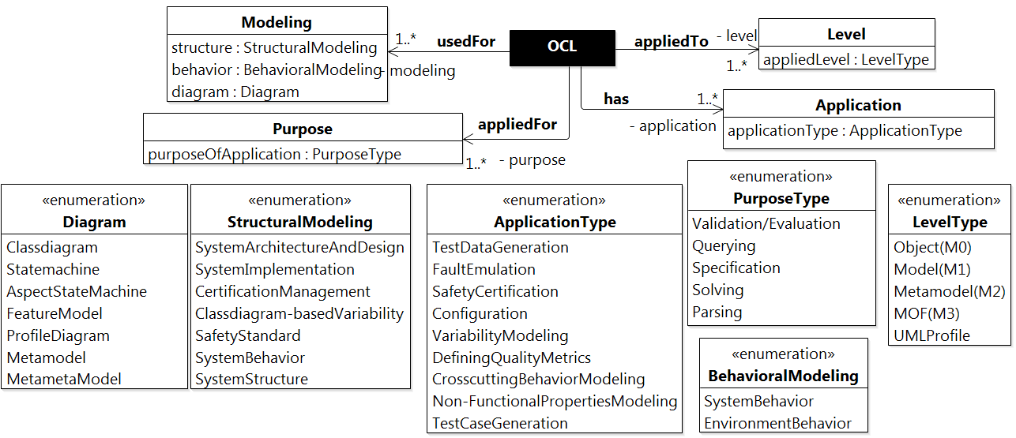
Overview of the OCL Terminology

Slide 9
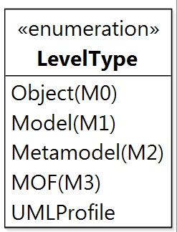
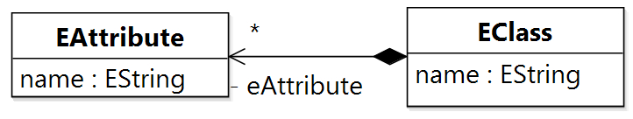
MOF Levels

Slide 10
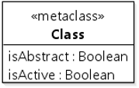
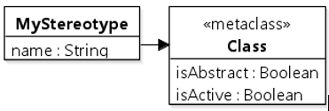
MOF Levels

Slide 11
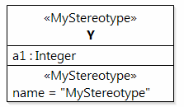
MOF Levels

Slide 12

MOF Levels

Slide 13

Specification Levels

Slide 14


Specification Levels

Slide 15

Specification Levels

Slide 16

Enforcement Levels

Slide 17

Enforcement Levels

Slide 18
Enforcement Levels

Slide 19
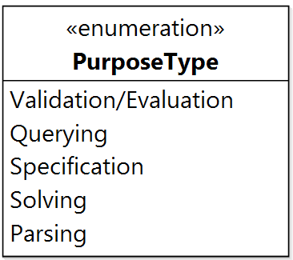
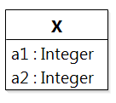

Purposes of OCL

Slide 20
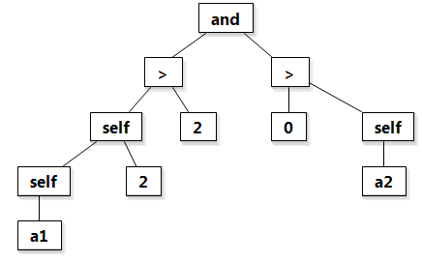
Purposes of OCL

Slide 21
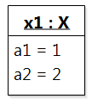

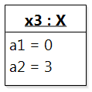
Purposes of OCL
true
false
undefined

Slide 22

Purposes of OCL

Slide 23
Purposes of OCL

Slide 24
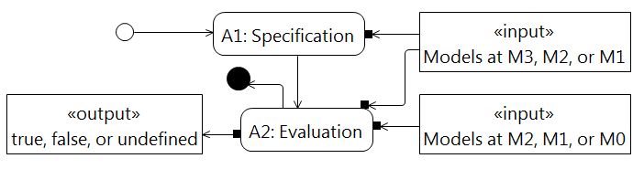
Relationship between Purposes

Slide 25
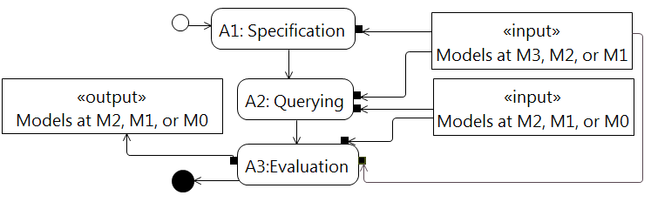
Relationship between Purposes

Slide 26
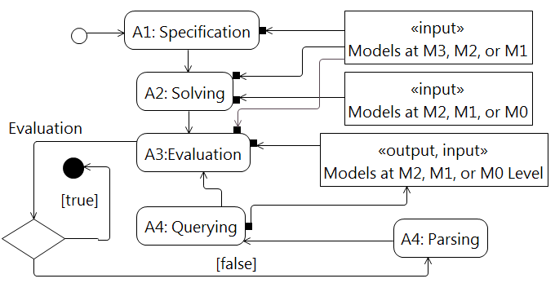
Relationship between Purposes

Slide 27
Industrial Applications

Slide 28
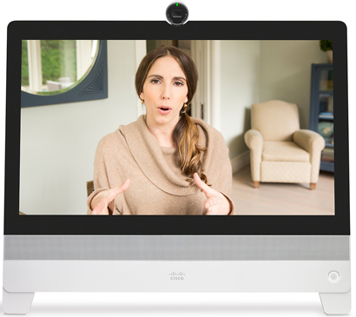
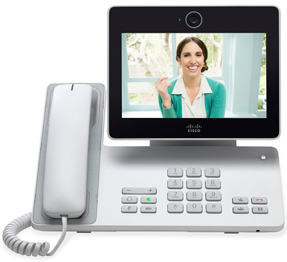
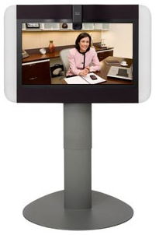
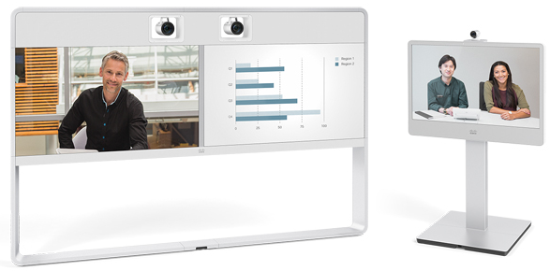
Model-based Testing of Video Conferencing Systems: Cisco
Product Lines of Video Conferencing Systems at Cisco

Slide 29
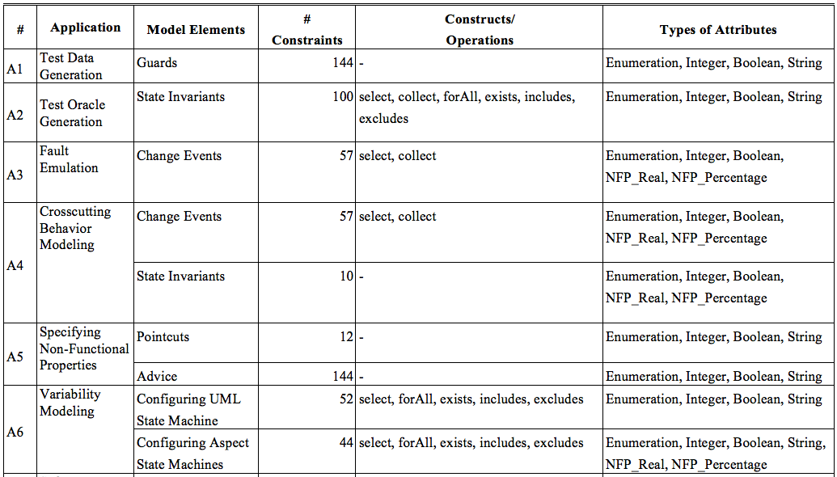
Model-based Testing of Video Conferencing Systems: Cisco

Slide 30
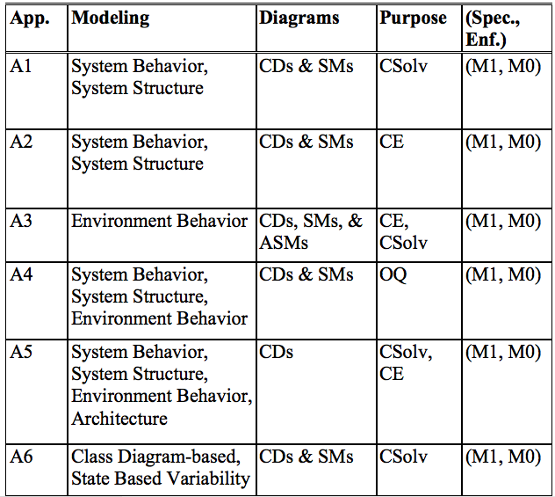
Model-based Testing of Video Conferencing Systems: Cisco
CD: Class Diagram
SM: State Machines
CSolv: Constraint Solving
CE: Constraint Evaluation
OQ: OCL Querying
RTES: Real-Time and Embedded System

Slide 31


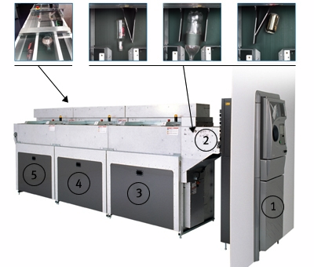
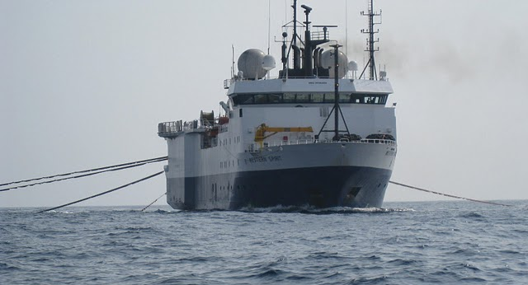
Environment Model-Based Testing: WesternGeco and Tomra
Bottle Recycling Machine
Marine Seismic Acquisition System
Soft RTES, Behavior driven by environment
Independent testing
  Focusing on illegal/unsafe environment conditions
Simulation
  Testing on development platform

Slide 32
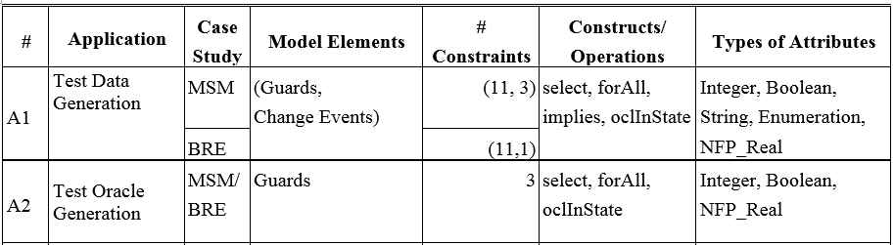
Environment Model-Based Testing: WesternGeco and Tomra
MSM: Marine Seismic Acquisition, BRE: Bottle Recycling

Slide 33
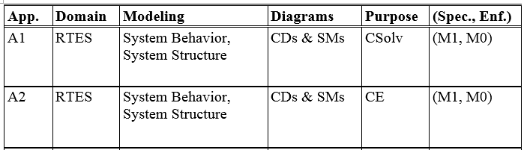
Environment Model-Based Testing: WesternGeco and Tomra
CD: Class Diagram, SM: State Machine, CSolv: Constraint Solving, CE: Constraint Evaluation, RTES: Real-Time and Embedded Systems

Slide 34
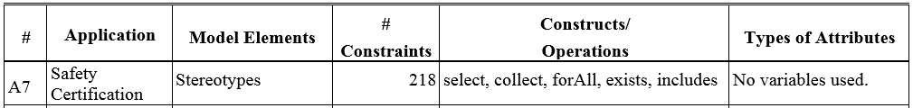
Safety Certification of subsea production control system: Kongsberg Maritime

Slide 35

Safety Certification of subsea production control system: Kongsberg Maritime
CD: Class Diagram, CE: Constraint Evaluation, OGP: Oil and Gas Production, ICS: Integrated Control System, RTES: Real-Time and Embedded System

Slide 36
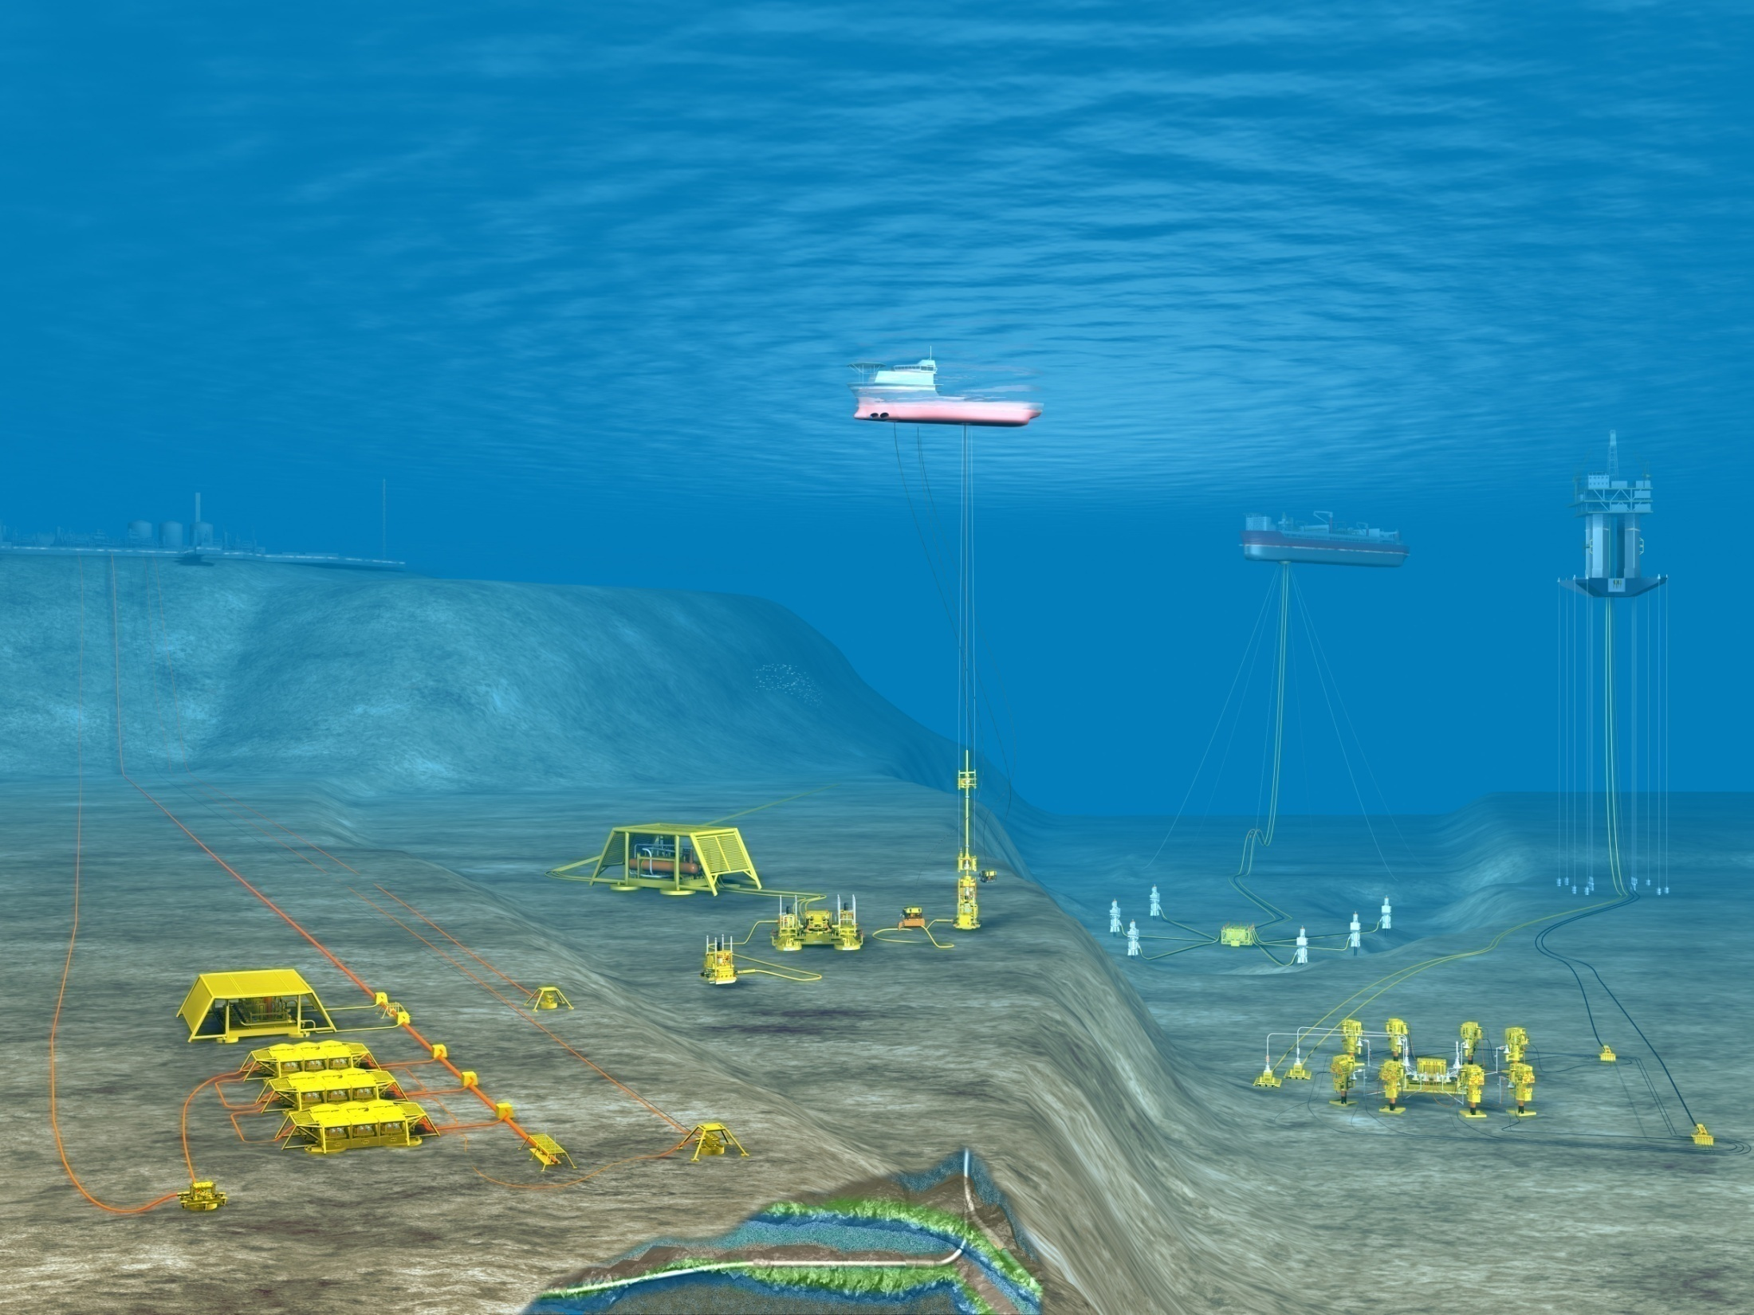
Architecture Modeling of subsea control modules : FMC Technologies
Large-scale, highly-hierarchical and high-configurable ICSs for managing exploitation of oil and gas production fields
Key components subsea control modules: software, electronics, instrumentation, and hydraulics for safety and efficient operation of subsea tree valves, and chokes
Subsea Field

Slide 37
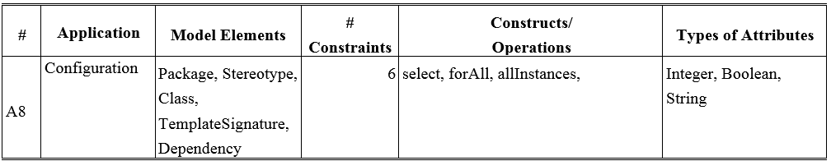
Architecture Modeling of subsea control modules : FMC Technologies

Slide 38
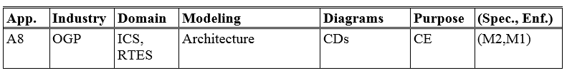
Architecture Modeling of subsea control modules : FMC Technologies
CD: Class Diagram, CE: Constraint Evaluation, OGP: Oil and Gas Production, ICS: Integrated Control System, RTES: Real-Time and Embedded System

Slide 39
Overall Discussion
Selecting a subset of OCL
  select, collect, and forAll
Choosing a Meta Level
  6/8 are related to MBT, secifying constraints at M1 and enforcing at M0
  2/8 with UML profiles, Constraints at the M2 level and enforced at M1
Choosing Diagram
  Class diagrams or equivalent as the basis
  Behavioral diagrams, UML Profiles, Metamodels
Selecting a purpose of OCL
  Evaluation (6/8) followed by solving (4/8)

Slide 40
Questions

