Slide 1
Towards an Extensible Modeling and Validation Framework for SDL-UML

Slide 2
Agenda
Introduction
Overview of SU-MoVal
OCL-based Model Validation
QVT-based Transformations
Demo of SU-MoVal
Conclusion and Future Work

Slide 3
1. Introduction
Current situation:
  A small number of tools supporting the combined use of SDL and UML.
  UML diagrams are translated to the concrete syntax of SDL.
  No support for a dedicated action language.
Latest edition of Z.109:
  Stereotypes for structural and behavioral modeling.
  Particular action language resting on a set of metaclasses.
  Concrete syntax for textual specification.
Objective of SU-MoVal:
  Prototypical implementation of the latest edition of Z.109.

Slide 4

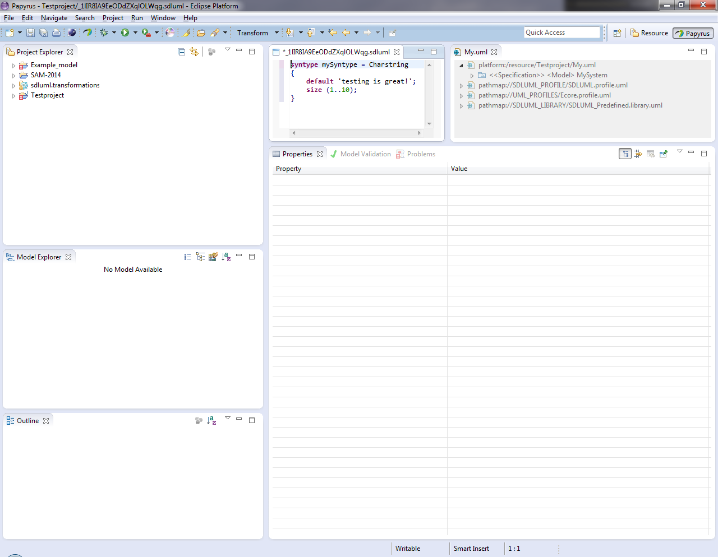
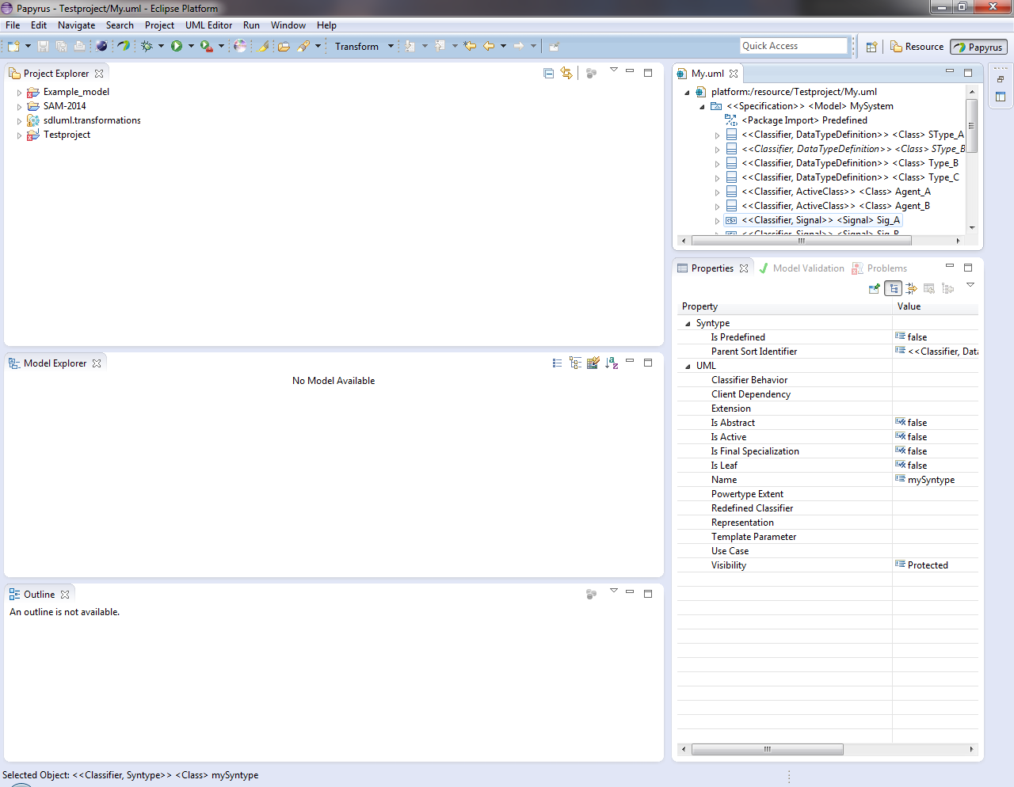


2. Overview of SU-MoVal
Components of the Framework
Textual Notation Editor
OCL Validation
Spoofax
UML Tree Editor
Model
Repository
QVTo
Transformations
Graphical UML Editor

Slide 5
2. Overview of SU-MoVal
The Graphical Editors
UML Tree Editor
Graphical UML Editor
Central component for:
Modeling
Application of stereotypes
Invoking the textual editor
Verification of defined constraints
Modeling of structural SDL-UML diagrams.
Further integrations of other features are planed.

Slide 6
2. Overview of SU-MoVal
The Textual Editor
Editor is generated with the Spoofax language workbench.
Support for a subset of the concrete syntax of SDL-2010.
Currently supported features:
  Syntax highlighting
  Syntax validation
  Disambiguation
Features on the roadmap:
  Syntax completion
  Additional syntax validation rules
Textual Notation Editor
Spoofax

Slide 7
3. OCL-based Model Validation
Challenges:
  Z.109 defines 339 constraints in natural language
  High complexity of some constraints
Solution:
  Implementation in terms of OCL constraints
  Reduction of complexity with OCL helper operations
Example Constraint:
’If the owner of an «Operation» is a «DataTypeDefinition», the method associated with the «Operation» shall be an «Activity».’
(self.isDataTypeMethod() or self.isDataTypeOperator())
implies base_Operation.method
->forAll(isStereotypedBy(’SDLUML::Activity’))

Slide 8
4. QVT-based Transformations
General Aspects
The QVT Operational component (QVTo) of Eclipse is used for:
  Transformation models for data types
  Expansion of short-hand notations
  Name resolution
  Mapping of concrete syntax to SDL-UML elements
Realization:
  Two transformation chains
  Transformations implemented as in-place and model-to-model transformations
  Patched version of QVTo for running pre-compiled transformations

Slide 9
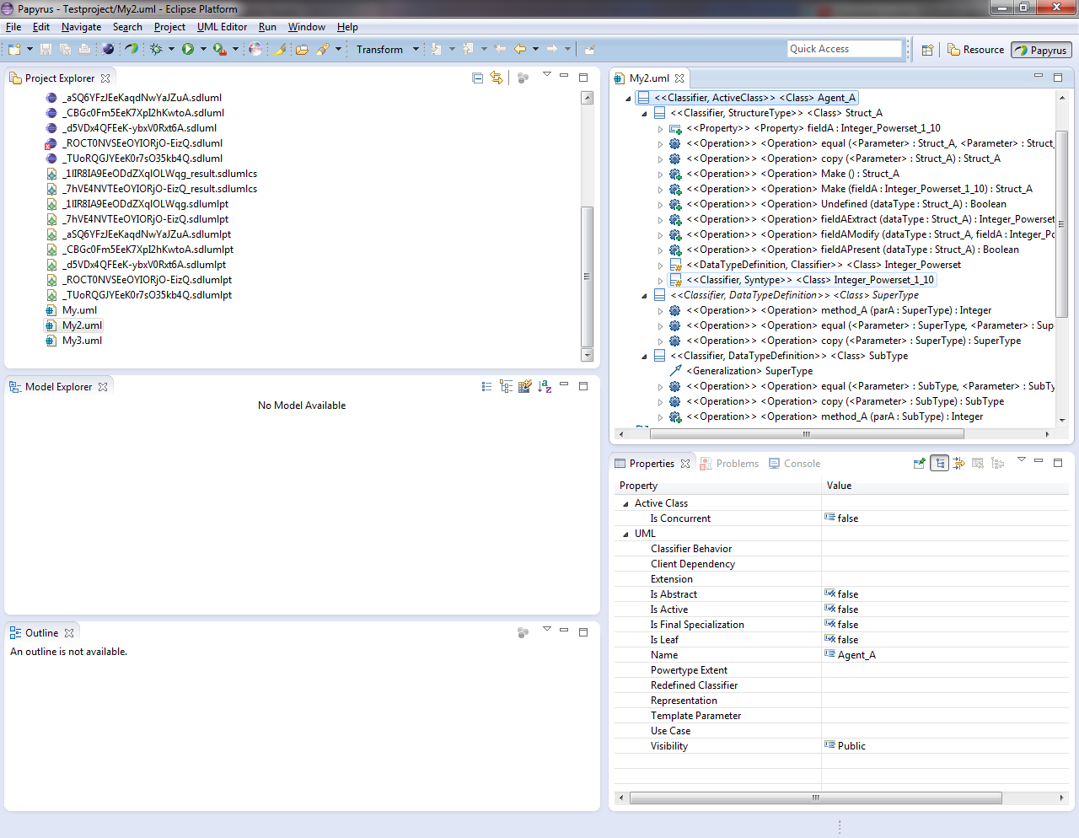
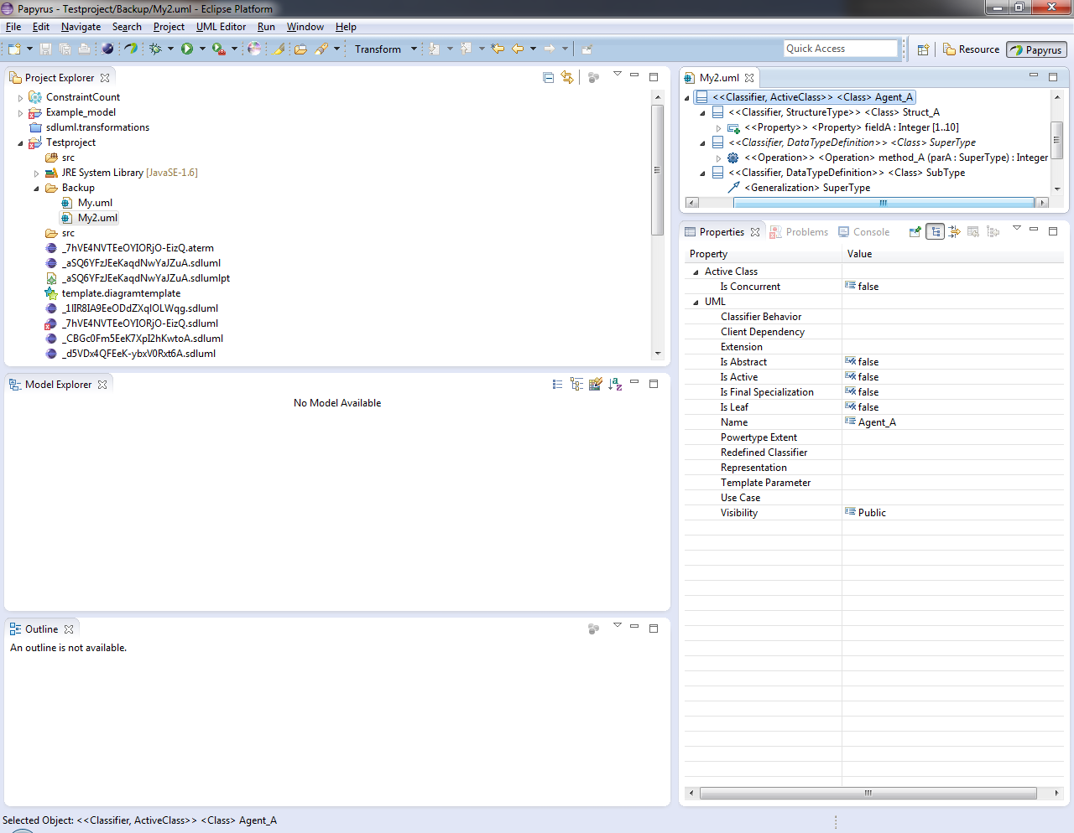
4. QVT-based Transformations
Data Type Transformations
Generic and implicit data type operations
Multi-valued properties
Definition of inherited operations
T₂
T₁
T₁
T₂
T₃
T₂
T₃

Slide 10
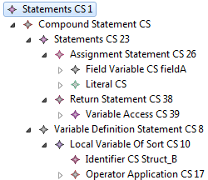
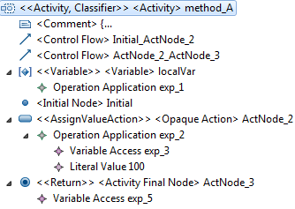
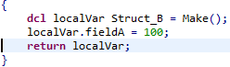
4. QVT-based Transformations
Textual Notation -> SDL-UML
Name resolution
Infix operators to operator applications
Extended
variables
Extended primary expressions
Method applications
SU
CS₁
CS₁
CS₂
CS₃
T₄
T₅
T₆
T₇
T₈
SU
CS₅
SU
CS₁
CS₄
T₄
Name resolution
SU
SU
CS₅
T₉
Mapping to SDL-UML
SU

Slide 11
5. Demo of SU-MoVal
Video

Slide 12
6. Conclusion and Future Work
The SU-MoVal framework proves the general applicability of the latest edition of Z.109.
A few features are not supported by SU-MoVal, e.g. mapping to the abstract syntax of SDL.
The binaries and the source code of SU-M#oVal can be obtained from:
http://www.su-moval.org
Drawbacks of Z.109:
  Constraints are only specified in natural language.
  Some stereotypes (e.g. «Pseudostate») represents different SDL constructs.
Future work:
  Mapping of SDL-UML elements to the abstract syntax of SDL.
  Missing features of the textual editor shall be implemented.
  A better integration of Papyrus.

